Slide 1
Reading With Your Eyes
Ashkan Bozorgzad, Kyle Diederich, Suhas Kumar, Ziqi Su

Slide 2
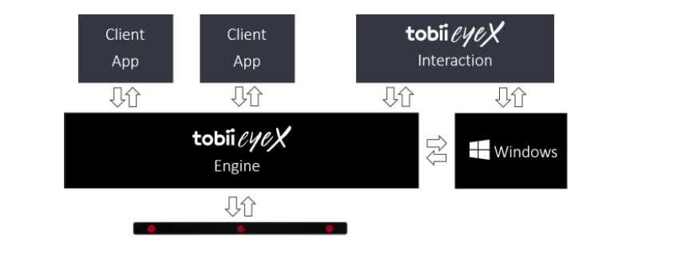
tobii eyeX Programming
Build application atop tobii eyeX Engine
Engine API provides only link between 3 systems:
Windows OS
App
Device

Slide 3
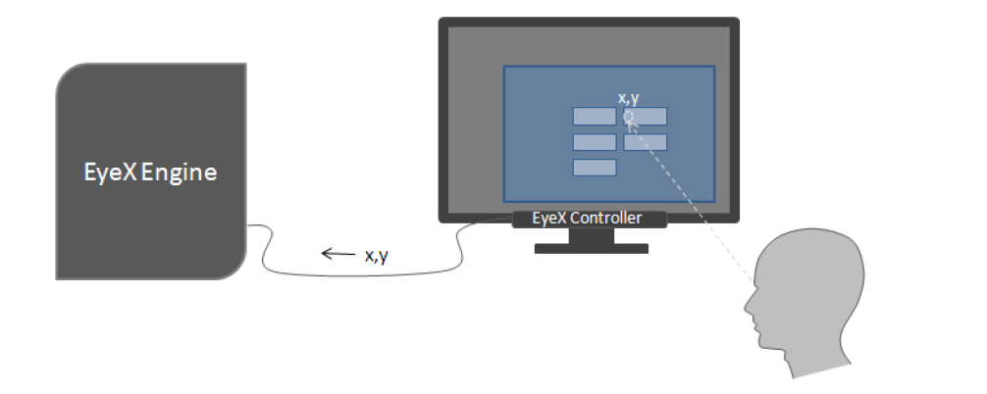
Control Flow of Application
The user looks at the screen, the EyeX controller calculates the coordinates of the gaze point
EyeX engine use information from client application and understand what kind of object the user is looking at and how to interact with it
Client application combine some user input and eye gazing to trigger the click on an object

Slide 4
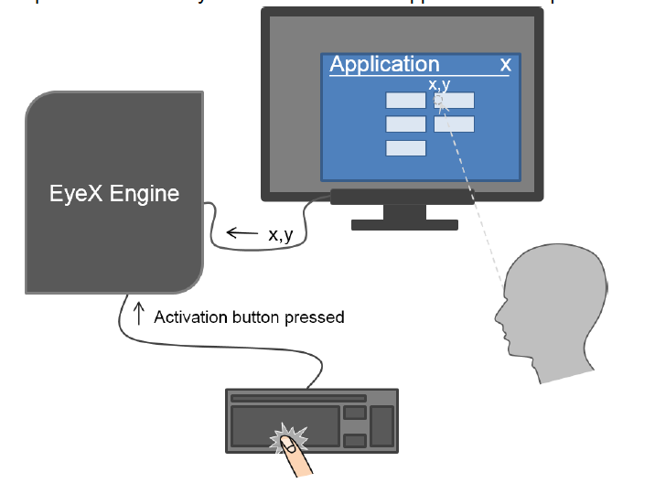
Control Flow of Application
The user press space bar when he or she is looking at the object and client application will tell EyeX engine that user want to activate the button. EyeX engine will trigger an event and tell client application to activate the specific button
Client application response to the event and give visual feedback.
Difference:
In step 3, instead of having some user input and eye gazing to trigger an event, we want to only use eye gazing to trigger a click on an object.
We want to trigger an event after eye gazing an object for a period of time

Slide 5
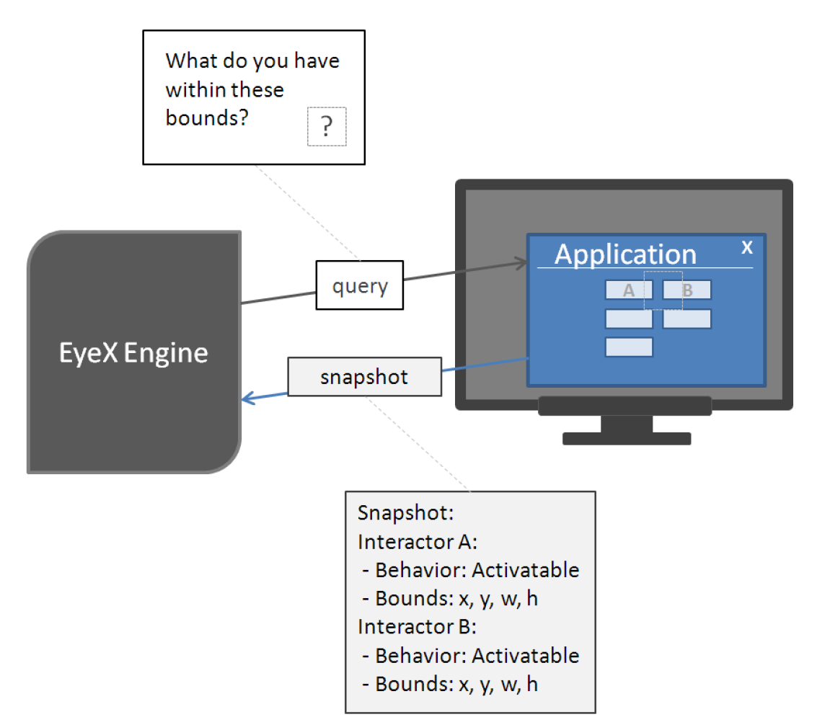
The Query Snapshot Cycle
First attempt to determine how to create interactors within application
Requires both keyboard and gaze in conjunction
Process:
Press key to activate snapshot
EyeX Engine queries screen to determine what item occurs at coordinates of user gaze

Slide 6
Gaze-Aware Behavior
Create a set of items that are interactable subject to user’s eye-gaze
Launch event when user’s gaze enters boundaries of interactor
Apply delay time
Add inertia to account to rapid, random eye movements
Gaze point must start on interactor until response is triggered
Manually adjustable delay parameter
Provide focus points:
Visual hotspot: captions, buttons, etc.
Sufficiently separation. Spacing around/between visual elements and/or increased size. (Tobii developers note: spacing effective than size.)
Care in visual feedback given. Example, highlight only text or visual hotspot of button.

Slide 7
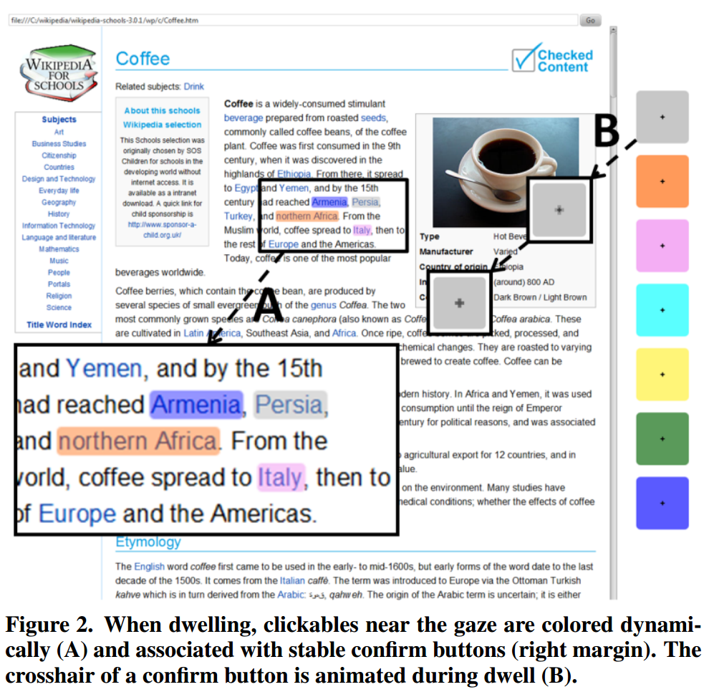
Gaze vs. Mouse
Gaze tends to be quick and natural
Can be slow and error prone
Difficulty distinguishing between intended or unintended gaze
actigaze
Attempts to solve the problem by using color coordination to confirm gaze targets
Allows for hands-free browsing of webpages
Current implementation only on selected Wikipedia articles (offline)
Requires algorithm to correctly identify and highlight clickable links
Lutteroth et al. 2015

